Slide 1
General Morphing
Joe Manke, Adam Meaney, & Jonathan Tomes

Slide 2
The basics
Modify the spatial relationship between pixels in an image
Consists of 2 basic operations
Spatial transformation of coordinates
Intensity interpolation

Slide 3
Multiple Approaches
Affine
Bilinear Transformation
Perspective

Slide 4
Affine Transformation

Slide 5
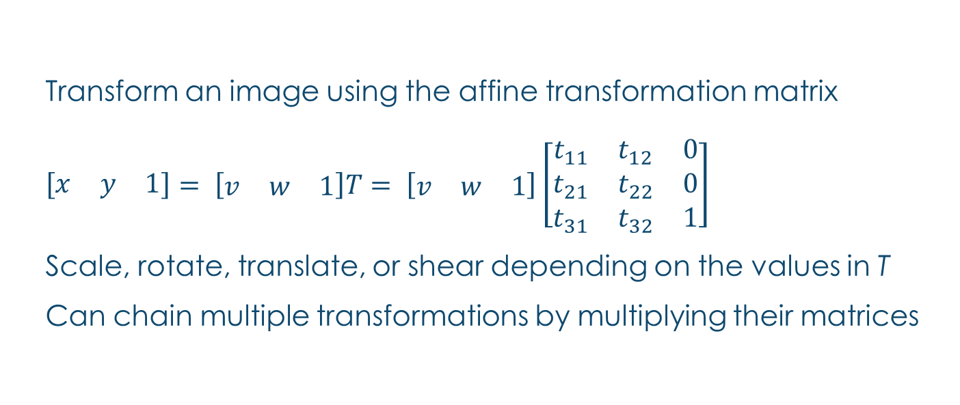
Affine Transformations
Transform an image using the affine transformation matrix
$\left[\begin{matrix}x & y & 1\end{matrix}\right]= \left[\begin{matrix}v & w & 1\end{matrix}\right]T= \left[\begin{matrix}v & w & 1\end{matrix}\right]\left[\begin{matrix}t_{11} & t_{12} & 0 \\ t_{21} & t_{22} & 0 \\ t_{31} & t_{32} & 1\end{matrix}\right]$
Scale, rotate, translate, or shear depending on the values in T
Can chain multiple transformations by multiplying their matrices

Slide 6
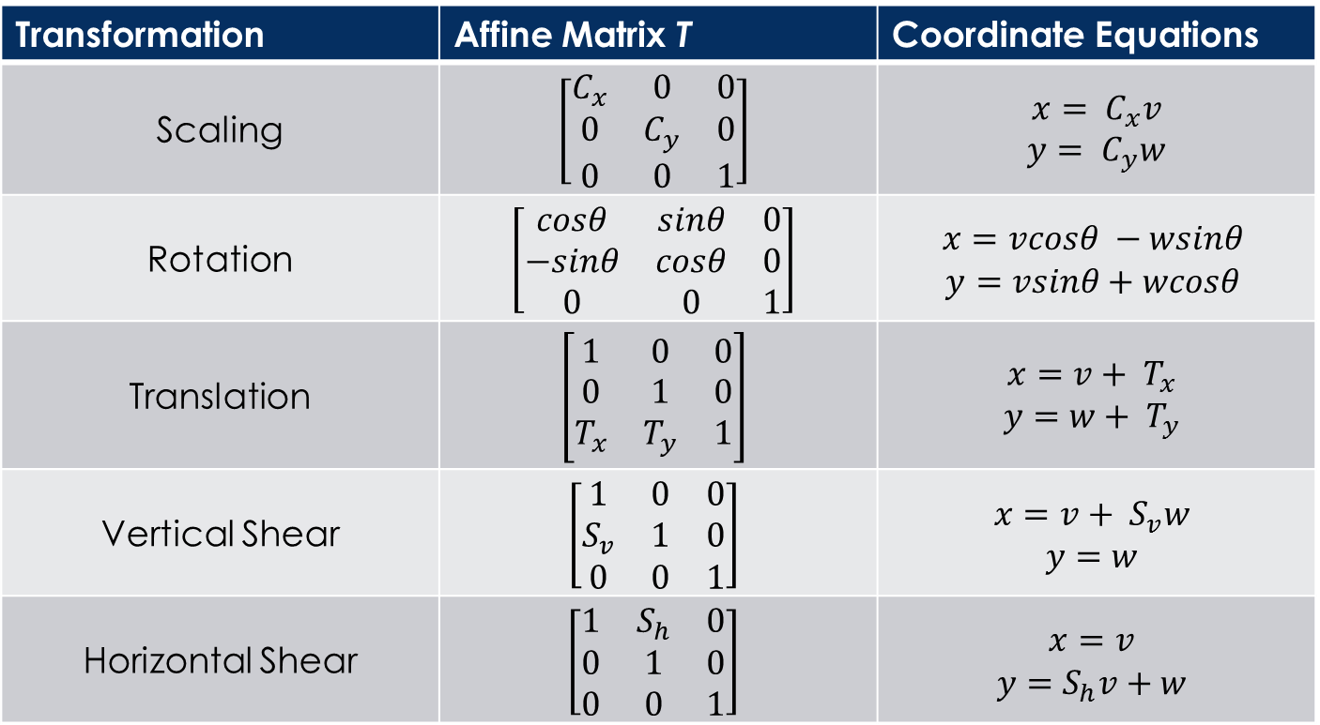
Affine Matrices and coordinate equations
Transformation | Affine Matrix T | Coordinate Equations
Scaling | $$\left[\begin{matrix}C_{x} & 0 & 0 \\ 0 & C_{y} & 0 \\ 0 & 0 & 1\end{matrix}\right]$$ | $$x= C_{x}v$$ $y= C_{y}w$
Rotation | $$\left[\begin{matrix}cosθ & sinθ & 0 \\ −sinθ & cosθ & 0 \\ 0 & 0 & 1\end{matrix}\right]$$ | $$x=vcosθ −wsinθ$$ $$y=vsinθ+wcosθ$$
Translation | $$\left[\begin{matrix}1 & 0 & 0 \\ 0 & 1 & 0 \\ T_{x} & T_{y} & 1\end{matrix}\right]$$ | $$x=v+ T_{x}$$ $$y=w+ T_{y}$$
Vertical Shear | $$\left[\begin{matrix}1 & 0 & 0 \\ S_{v} & 1 & 0 \\ 0 & 0 & 1\end{matrix}\right]$$ | $$x=v+ S_{v}w$$ $$y=w$$
Horizontal Shear | $$\left[\begin{matrix}1 & S_{h} & 0 \\ 0 & 1 & 0 \\ 0 & 0 & 1\end{matrix}\right]$$ | $$x=v$$ $$y=S_{h}v+w$$

Slide 7
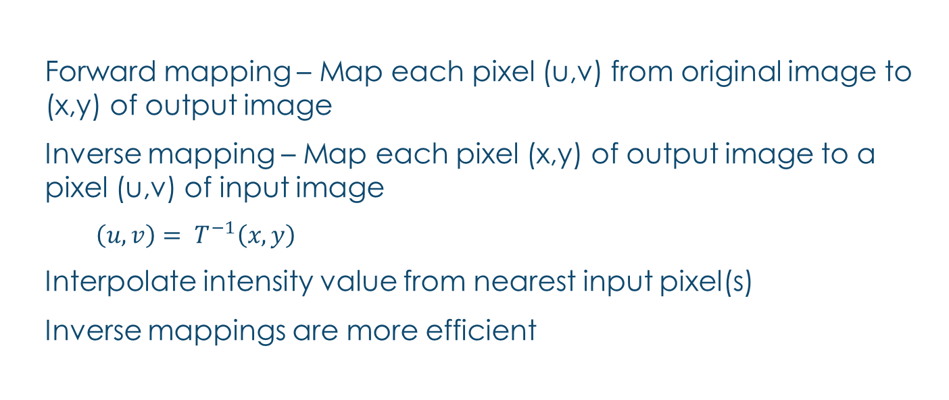
Forward and inverse mapping
Forward mapping – Map each pixel (u,v) from original image to (x,y) of output image
Inverse mapping – Map each pixel (x,y) of output image to a pixel (u,v) of input image
$\left(u,v\right)= T^{−1}\left(x,y\right)$
Interpolate intensity value from nearest input pixel(s)
Inverse mappings are more efficient

Slide 8

Inverse equations
Scaling
$v=x/C_{x}$
$w=y/C_{y}$
Rotation
$v=\left(x−x_{0}\right)cosθ−\left(y−y_{0}\right)sinθ+x_{0}$
$w=\left(y−y_{0}\right)cosθ+\left(x−x_{0}\right)sinθ+y_{0}$
$(x_{0},y_{0})$= center of image

Slide 9
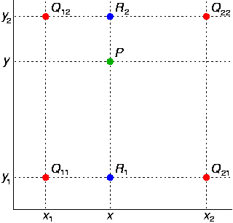
Bilinear Interpolation
R1 = ((x2 – x)/(x2 – x1))*Q11 +
((x – x1)/(x2 – x1))*Q21
R2 = ((x2 – x)/(x2 – x1))*Q12 +
((x – x1)/(x2 – x1))*Q22
P = ((y2 – y)/(y2 – y1))*R1 +
((y – y1)/(y2 – y1))*R2

Slide 10
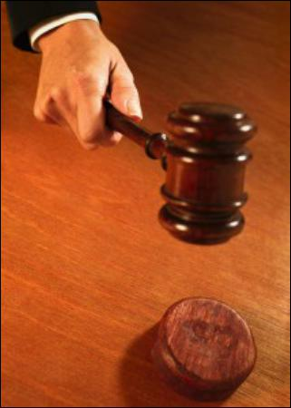


Comparison
Bilinear
Nearest Neighbor
Original

Slide 11


Comparison
Original
Bilinear
Nearest Neighbor

Slide 12
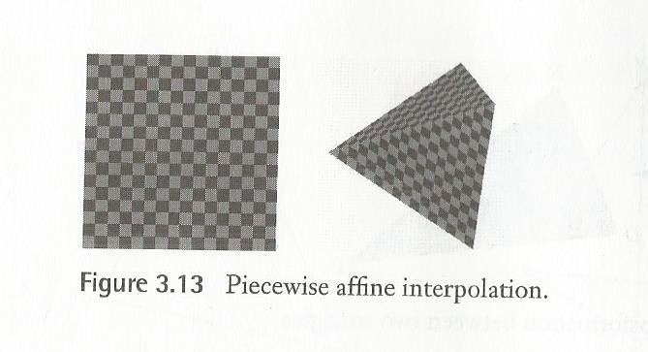
Not the Best Solution
Works well for mapping triangles
Done piecewise on other shapes
The transformation is continuous, but there is discontinuity in the first derivative

Slide 13
Bilinear and Perspective

Slide 14
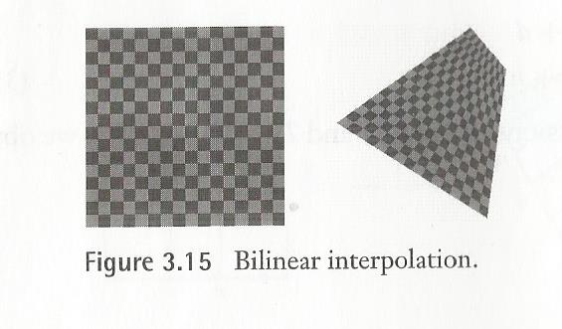
BilINear
Pros
Non-planar – useful for mapping none 2-D things
Very General
Cons
Non-planar – none vertical or horizontal lines map to quadratic curves
Quadratic in the Inverse

Slide 15
Perspective Transform
Pros
uses matrix operations much like the affine Transformations
Planar like the Affine Transformations – does Quadrilateral transforms well
Lines remain lines - though they foreshorten distant lines to a vanishing point, renders a nice realistic image
Cons
Not as general as bilinear

Slide 16
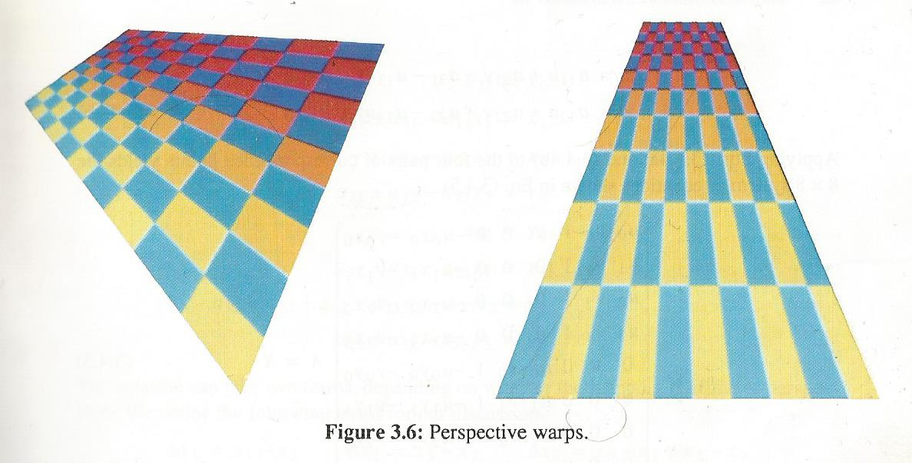
Doing the Perspective Transform

Slide 17

The Forward Equations
$\left[x^{′}, y^{′},w′\right]= \left[u,v,w\right] A$
$x= \frac{x′}{w′}= \frac{a_{11}u+a_{21}v+a_{31}}{a_{13}u+a_{23}v+a_{33}}$
$y= \frac{y′}{w′}= \frac{a_{12}u+a_{22}v+a_{32}}{a_{13}u+a_{23}v+a_{33}}$

Slide 18
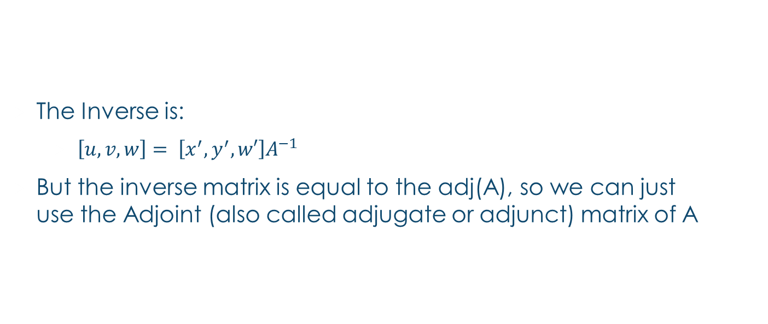
The Inverse Equations
The Inverse is:
$\left[u,v,w\right]= \left[x^{′},y^{′},w′\right]A^{−1}$
But the inverse matrix is equal to the adj(A), so we can just use the Adjoint (also called adjugate or adjunct) matrix of A

Slide 19

Inferring PerSpective Transformations
$a_{33}=1$
$x= a_{11}u+ a_{21}v+a_{31}−a_{13}ux− a_{23}vx$
$y= a_{12}u+ a_{22}v+a_{32}−a_{13}uy− a_{23}vy$

Slide 20

Case 1: Square to Quadrilateral
First some Definitions:
$∆x_{1}= x_{1}− x_{2}$ , $∆x_{2}= x_{3}− x_{2}$, $∆x_{3}= x_{0}− x_{1}+ x_{2}− x_{3}$
$∆y_{1}= y_{1}− y_{2}$, $∆y_{2}= y_{3}− y_{2}$, $∆y_{3}= y_{0}− y_{1}+ y_{2}− y_{3}$

Slide 21

$a_{11}=x_{1}−x_{0}+a_{13}x_{1}$
$a_{21}=x_{2}−x_{1}+a_{23}x_{3}$
$a_{31}=x_{0}$
$a_{12}=y_{1}−y_{0}+a_{13}y_{1}$
$a_{22}=y_{2}−y_{1}+a_{23}y_{3}$
$a_{32}=y_{0}$
$a_{13}=0$ OR $\frac{\left|\begin{matrix}∆x_{3} & ∆x_{2} \\ ∆y_{3} & ∆y_{2}\end{matrix}\right|}{\left|\begin{matrix}∆x_{1} & ∆x_{2} \\ ∆y_{1} & ∆y_{2}\end{matrix}\right|} if ∆x_{3}\text{ != 0 }\text{and} ∆y_{3}\text{ != 0}$
$a_{23}=0$ OR $\frac{\left|\begin{matrix}∆x_{1} & ∆x_{3} \\ ∆y_{1} & ∆y_{3}\end{matrix}\right|}{\left|\begin{matrix}∆x_{1} & ∆x_{2} \\ ∆y_{1} & ∆y_{2}\end{matrix}\right|}if$ $∆x_{3}$ != 0 and $∆y_{3}$ != 0

Slide 22
Case 2: Quadrilateral to Square
Do Case 1 then find the inverse matrix (the Adj of the A you get)

Slide 23
Case 3: Quadrilateral to Quadrilateral
Do case 2 then Case 1

Slide 24
References:
Warping and Morphing of Graphical Objects
by Jonas Gomes, Lucia Darsa, Bruno Costa, Luiz Velho
Digital Image Warping
by George Wolberg
Digital Image Processing
by Rafael C. Gonzalez , Richard E. Woods

